Slide 1


Slide 2

Artificial "Directed Musement" and Its Limitations
May 25, 2024
Anemily Machina
Department Here
Notes:
as you might guess from the title there is currently no purposelessness in generative text AI or modern machine learning. Generative text AIs are forced to end any “musement” in the usefulness of next-token prediction. Which is not to say that an analogy of musement does not exist, but rather these machines muse in a similar way to as priest describe “a process of concatenated inferences that become ever more well defined”

Slide 3

Demystifying Generative Text AIs
Presentation Title Here

Slide 4
The training of AIs itself can be thought of as similar to Schiller’s sense drive (making a prediction and receiving a positive or negative signal) and form drive (updating the internal world based on the signal) (O’Connor, 2014), but this never harmonizes into play.
Presentation Title Here
Notes:
a billion parameters is a list of 1 billion number and some instructions on how to use those number

Slide 5
SimpleGPT
Presentation Title Here

Slide 6
SimpleGPT
[4.0, 1.2, 2.1]
Presentation Title Here

Slide 7
SimpleGPT
[4.0, 1.2, 2.1]
Input | ?
Multiply by 4.0 | ?
Add 1.2 | ?
Divide by 2.1 | ?
Presentation Title Here

Slide 8
SimpleGPT
[4.0, 1.2, 2.1]
“I saw a”
Input | ?
Multiply by 4.0 | ?
Add 1.2 | ?
Divide by 2.1 | ?
Presentation Title Here

Slide 9
SimpleGPT
[4.0, 1.2, 2.1]
“I saw a”
2
Input | ?
Multiply by 4.0 | ?
Add 1.2 | ?
Divide by 2.1 | ?
Presentation Title Here

Slide 10
SimpleGPT
[4.0, 1.2, 2.1]
“I saw a”
2
Multiply by 4.0 | 8.0
Add 1.2 | 9.2
Divide by 2.1 | 4.38
Input | ?
Multiply by 4.0 | ?
Add 1.2 | ?
Divide by 2.1 | ?
2
Presentation Title Here

Slide 11
SimpleGPT
[4.0, 1.2, 2.1]
“I saw a”
2
Multiply by 4.0 | 8.0
Add 1.2 | 9.2
Divide by 2.1 | 4.38
Input | ?
Multiply by 4.0 | ?
Add 1.2 | ?
Divide by 2.1 | ?
2
4.38
Presentation Title Here

Slide 12
SimpleGPT
[4.0, 1.2, 2.1]
“I saw a”
2
Multiply by 4.0 | 8.0
Add 1.2 | 9.2
Divide by 2.1 | 4.38
Input | ?
Multiply by 4.0 | ?
Add 1.2 | ?
Divide by 2.1 | ?
2
1 | I
2 | saw
3 | a
4 | dog
5 | cat
6 | person
4.38
Presentation Title Here

Slide 13
SimpleGPT
[4.0, 1.2, 2.1]
“I saw a”
2
Multiply by 4.0 | 8.0
Add 1.2 | 9.2
Divide by 2.1 | 4.38
Input | ?
Multiply by 4.0 | ?
Add 1.2 | ?
Divide by 2.1 | ?
2
1 | I
2 | saw
3 | a
4 | dog
5 | cat
6 | person
4.38
Presentation Title Here

Slide 14
SimpleGPT - After Training
Presentation Title Here

Slide 15
SimpleGPT - After Training
Training Data
I saw a dog
I saw a cat
I saw a person
Presentation Title Here

Slide 16
SimpleGPT - After Training
Training Data
I saw a dog
I saw a cat
I saw a person
Sentence | Generation Frequency
I saw a dog | 33%
I saw a cat | 33%
I saw a person | 33%
Presentation Title Here

Slide 17
SimpleGPT - After Training
Training Data
I saw a dog
I saw a cat
I saw a person
Training Data
I saw a dog
I saw a cat
I saw a person
I saw a dog
Sentence | Generation Frequency
I saw a dog | 33%
I saw a cat | 33%
I saw a person | 33%
Presentation Title Here

Slide 18
SimpleGPT - After Training
Training Data
I saw a dog
I saw a cat
I saw a person
Training Data
I saw a dog
I saw a cat
I saw a person
I saw a dog
Sentence | Generation Frequency
I saw a dog | 33%
I saw a cat | 33%
I saw a person | 33%
Sentence | Generation Frequency
I saw a dog | 100%
I saw a cat | 0%
I saw a person | 0%
Presentation Title Here

Slide 19
SimpleGPT - Change Prediction Instructions
Training Data
I saw a dog
I saw a cat
I saw a person
I saw a dog
1 | I
2 | saw
3 | a
4 | dog
5 | cat
6 | person
4.38
Sentence | Generation Frequency
I saw a dog | 50%
I saw a cat | 25%
I saw a person | 25%
Presentation Title Here

Slide 20
Interesting Things do Happen
Presentation Title Here

Slide 21
Interesting Things do Happen
The next token after “I tasted the most delicious …” must all be close to each other
Presentation Title Here

Slide 22
Interesting Things do Happen
The next token after “I tasted the most delicious …” must all be close to each other
… | …
112 | sushi
113 | curry
114 | pizza
115 | cake
116 | nachos
… | ..
Presentation Title Here

Slide 23
Artificial Musement
Presentation Title Here

Slide 24
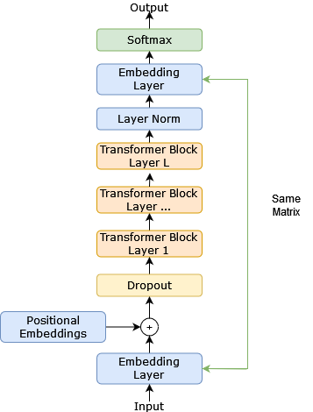
Intermediate Outputs
An AI’s next-token decision can be broken down into a series of steps
Each step has its own (complex) output that can be evaluated
Only the last output is constrained to predict the next-token
Presentation Title Here

Slide 25
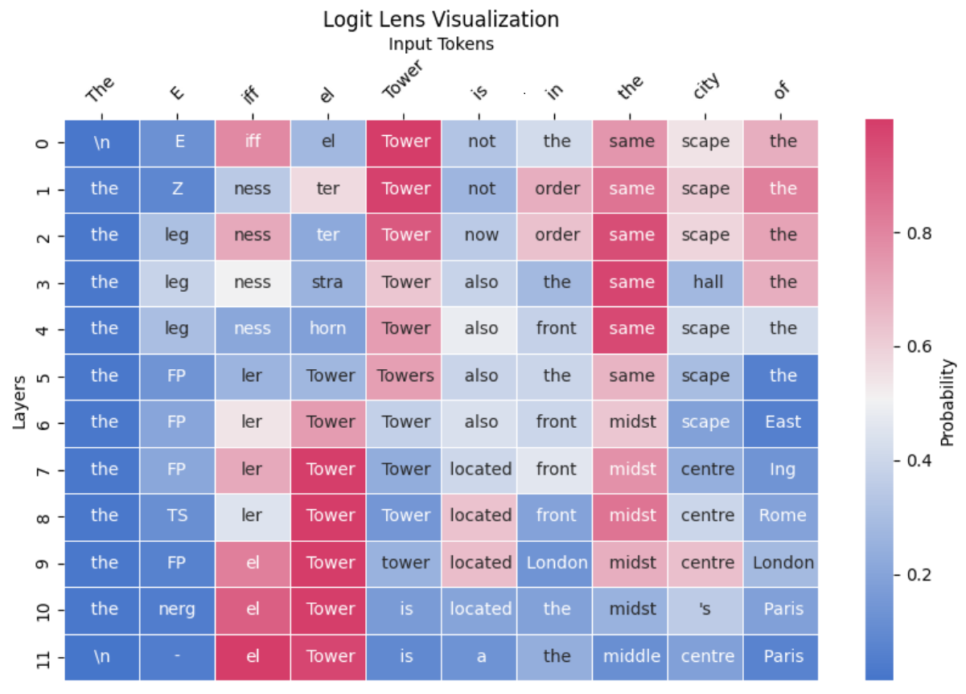
Logit Lens
https://nnsight.net/notebooks/tutorials/logit_lens/
Presentation Title Here
Notes:
owever like Cooke’s description of musement (Cooke,
2018) there are no real errors in the next-token prediction in the final layer, the AI is doing exactly as
it was trained. We as humans may be disappointed in the results though, as we are the ones that
have an expectation for this process

Slide 26
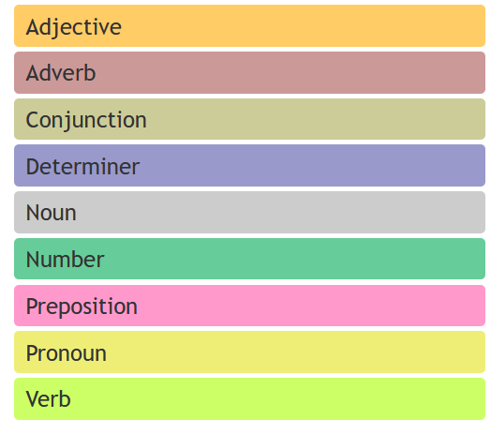
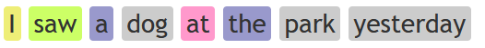
Probing Tasks
Try to train a different (simple) AI on the intermediate outputs of a complex AI ” (Shi et al., 2016)
Simple AI is trained on tasks like: predict the parts of speech tag
Presentation Title Here

Slide 27
Probing Task
Parts of Speech Detected
Word Sense
Detected
https://nnsight.net/notebooks/tutorials/logit_lens/
Presentation Title Here
Notes:
“drift[ing] towards certain thoughts that it finds interesting and worth considering more carefully.” (priest)

Slide 28
Artificial Thought
Presentation Title Here

Slide 29
Concept Erasure
You can provably erase any concept from a generative AI (Belrose et al., 2023)
E.g., gender or freedom
Presentation Title Here

Slide 30
Model Collapse
If you train an AI on the outputs of another AI their is a loss of expressibility
Presentation Title Here

Slide 31


Model Collapse
https://www.rpgmakerweb.com/blog/randomness-in-npc-dialogue
Presentation Title Here

Slide 32
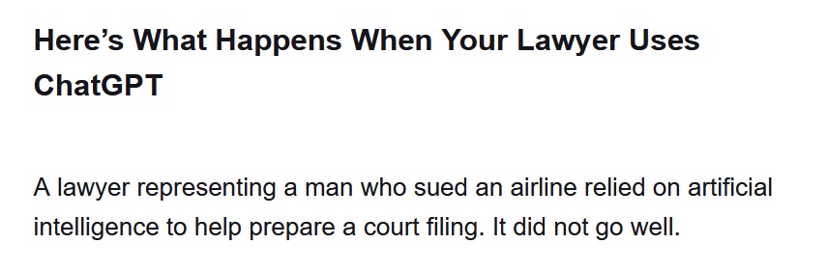
Hallucinations
When generating a next token, the AI doesn’t take into account the factual correctness of the words
https://www.nytimes.com/2023/05/27/nyregion/avianca-airline-lawsuit-chatgpt.html
Presentation Title Here

Slide 33
The Chicken and Egg of AGI
Presentation Title Here

Slide 34
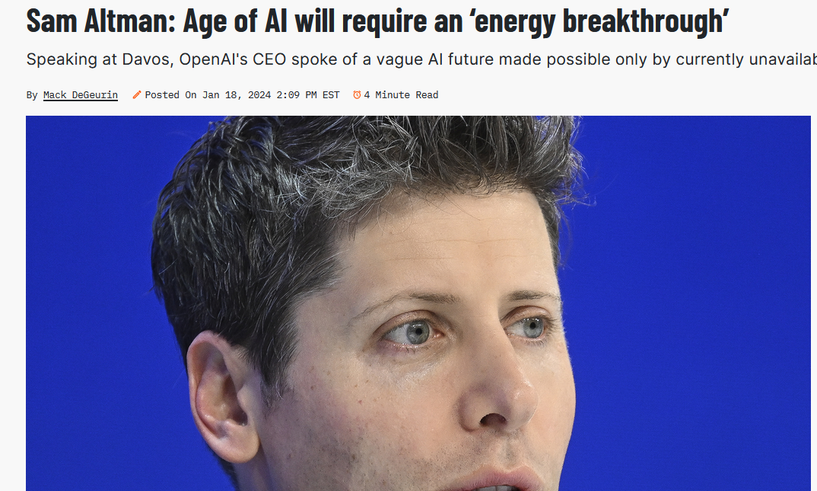
Extreme Energy Costs
Even one generation is quite costly: using 100s of prompts to generate the best picture even more so (Sasha Luccioni et al., 2023)
https://www.popsci.com/technology/sam-altman-age-of-ai-will-require-an-energy-breakthrough/
Presentation Title Here

Slide 35
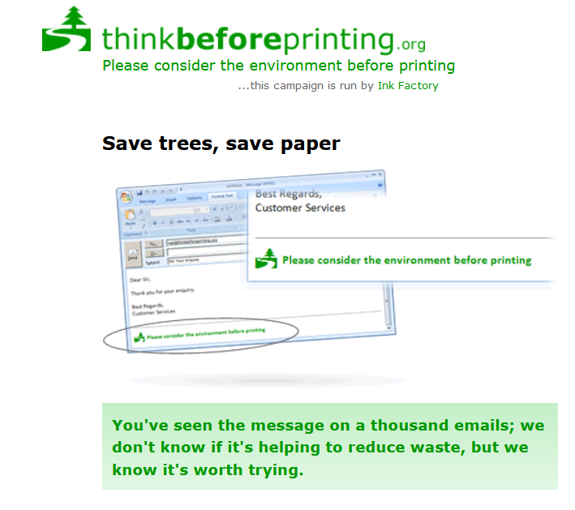
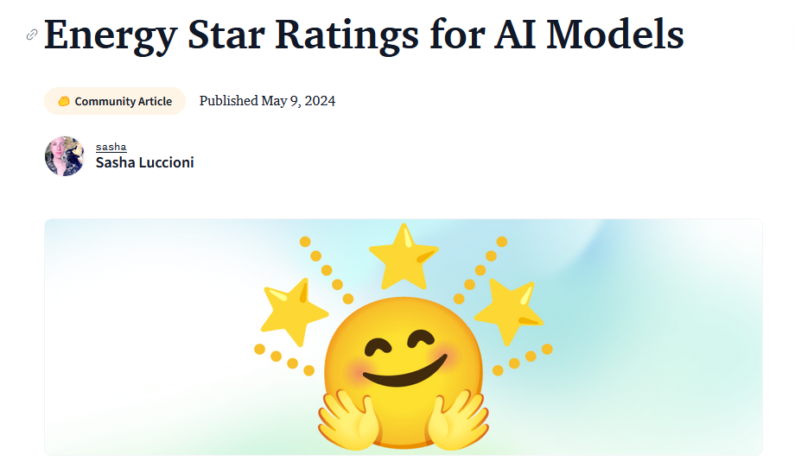
A Social Change?
https://thinkbeforeprinting.org/ https://huggingface.co/blog/sasha/energy-star-ai-proposal
Presentation Title Here

Slide 36
The Future
Presentation Title Here

Slide 37
The Wrong Tool for the Problem
Presentation Title Here

Slide 38
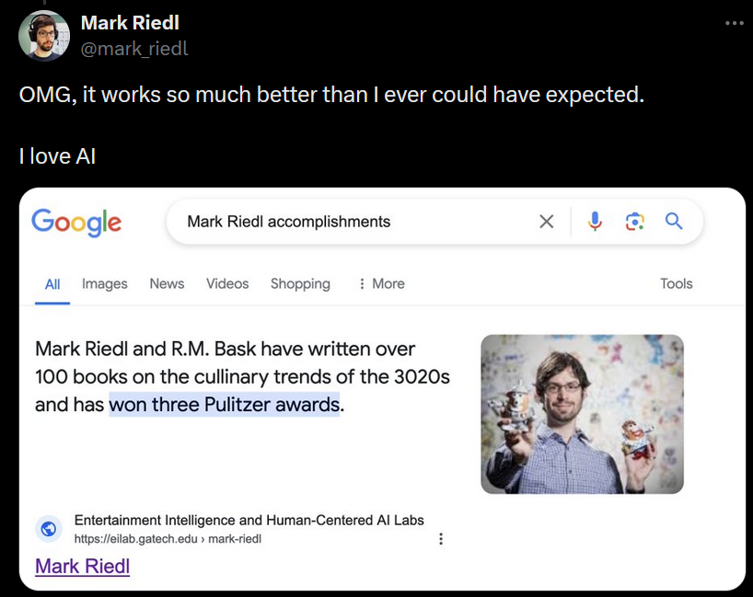
The Wrong Tool for the Problem
Presentation Title Here

Slide 39
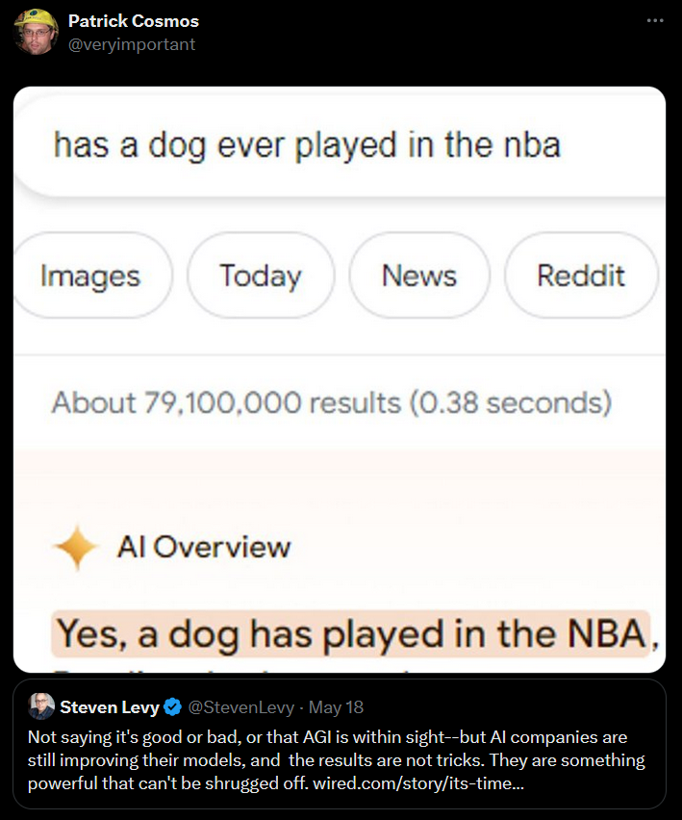
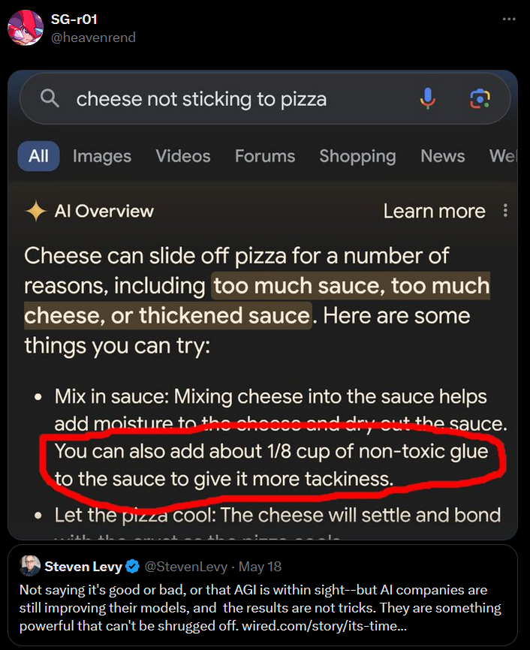
The Wrong Tool for the Problem
Presentation Title Here

Slide 40
Hopefulness
HuggingFace recently released a huge 15 trillion token English language dataset (Penedo et al., 2024)
Advances in algorithms (instructions): e.g. force the next token to follow the rules of a given language (huggingface.co)
Presentation Title Here

Slide 41
Limiting Research
“Why does it matter whether text-manipulation systems can produce output for these tasks that are similar to answers that people give when faced with the same questions?” she asks. “What does that teach us about the internal workings of LLMs, what they might be useful for, or what dangers they might pose?” It’s not clear, Bender says, what it would mean for a LLM to have a model of mind, and it’s therefore also unclear if these tests measured for it. - Dr. Emily Bender
https://thinkbeforeprinting.org/ https://huggingface.co/blog/sasha/energy-star-ai-proposal
Presentation Title Here

Slide 43
References
Brian O’Connor. 2014. Play, idleness and the problem of necessity in schiller and marcuse. British Journal for the History of Philosophy, 22(6):1095–1117.
Eldritch Priest. 2024. On Musement and Radical Thought. Accelerated Ad(E)vent.
Xing Shi, Inkit Padhi, and Kevin Knight. 2016. Does string-based neural MT learn source syntax? In Proceedings of the 2016 Conference on Empirical Methods in Natural Language Processing, pages 1526–1534, Austin, Texas. Association for Computational Linguistics.
Nora Belrose, David Schneider-Joseph, Shauli Ravfogel, Ryan Cotterell, Edward Raff, and Stella Biderman. 2023. LEACE: Perfect linear concept erasure in closed form. In Thirty-seventh Conference on Neural Information Processing Systems.
Alexandra Sasha Luccioni, Yacine Jernite, and Emma Strubell. 2023. Power Hungry Processing: Watts Driving the Cost of AI Deployment? arXiv e-prints, page arXiv:2311.16863.
Guilherme Penedo, Hynek Kydlíček, Leandro von Werra, and Thomas Wolf. 2024. Fineweb.
Presentation Title Here

